Slide 1
Utility Task Force Recommendations
Presented to
Select Board Members
September 1, 2026

Slide 2
Task Force Members
Town Staff Support
David Bernstein
Tim Jenkins
Leslie Lewis
David Odland
Kate Taylor
Ed Walker
Steve Waker
Nate Brown
Lilli Gilligan
Beth Marsh
Select Board Laision: Bonnie Tucker

Slide 3
Goals: Revenues Meet Expenditures And Fairness Across Water Use Spectrum
Revenue Meets Expenditures
Economic Development
Fairness Across the Water Use Spectrum
Conservation Promotion

Slide 4
Agenda
Current Fund Balance in the Water and Sewer Enterprises
Target Revenue for Task Force Recommendations
Total Town Water Volume Usage Across Past 8 Years Informs Interpretation of Model Predictions
Recommendations:
  Proposed Rate Structure
  Proposed Rates
    Impact Analysis of Proposed Rate Structure and Proposed Rates on Accounts Along the Volume Spectrum
  Proposed Frequency of Review by the Select Board

Slide 5
Current Water and Sewer Enterprise Fund Balances
Fund balances fund capital and non-repeating expenditures
Water Enterprise* Fund Balance
$3,605,572
Sewer Enterprise* Fund Balance
$3,148,481
* Fund Balance as of July 1, 2026
Notes:
The upcoming year is supported by revenues collected through water or water and sewer bills collected throughout the year
At the end of the year you may have added or reduced the Fund Balance based on spending compared to collections of revenue from water and water and sewer bill payers
And the Fund Balance is reduced when the dollars in the Fund Balance are used for capital improvements and non-repeating expenditures

Slide 6
Target Revenues
Revenues/Expenditures | Water | Sewer
Total Revenue Matching Total Expenditures – FY 27 | $1,807,464 | $2,015,734
Non-User Revenues | $617,355 | $935,960
Capital and Non-Repeating Expenditures | $260,000 | $192,000
Target Revenues | $1,190,109 | $1,079,774

Slide 7
Total Town Water Volume Usage For Past 8 Years Resembles Dry Year Volume Assumption in Rate Model
Year | Actual Town Water Use (cuft) | Model (cuft) – Dry Year | Model (cuft) – Wet Year
2026 | 17,206,500 | 17,118,003 | 12,011,080
2025 | 17,379,669
2024 | 16,402,400
2023 | 16,330,500
2022 | 15,548,555
2021 | 15,715,431
2020 | 16,470,363
2019 | 16,988,638
Average | 16,505,257

Slide 8
Recommendation #1: Proposed Rate Structure
Fixed cost for water and for sewer access
Multiplier of fixed cost based on meter size
  Explained further on the next slide
One single variable rate for all accounts (1 tier)
No consumer allowance
  All users pay the variable rate starting with the first cubic foot used

Slide 9
Multiplier of fixed cost based on meter size
A multiplier is added to the fixed cost as the meter size increases
  Used in Keene and Bow
Meter Size In Inches | Multiplier | Water $ Impact | Sewer $ Impact | Number of Accounts
5/8 | 1 | 20.89 | 29.52 | 1,785
3/4 | 1.5 | 31.34 | 44.27 | 43
1 | 2.5 | 52.23 | 72.78 | 56
1 1/2 | 5 | 104.45 | 147.55 | 21
2 | 8 | 167.12 | 472.16 | 20
3 | 16 | 334.24 | 472.16 | 12
4 | 25 | 522.25 | 737.75 | 1
Notes:
In the case of multiple dwelling buildings with one meter, the whole building pays one fixed cost which is divided among the unit
Each unit pays a fraction of the fixed cost, in comparison, the same number of houses would require paying the full fixed cost

Slide 10
Recommendation #2: Proposed Rates for Water
The fixed rate remains the same as the current fixed rate with the multiplier applied based on meter size – called Meter Fee
  Multiplier applied to the model for predictions
 | Quarterly Meter Fee (Not including multiplier) | Customer Allowance | Tier 1 Rate | Tier 2 Rate 1,000 cuft | Tier 3 Rate 6,000 cuft
Original | $46.41 | 750 | 0.06188
Current | $20.89 | 300 | 0.08911 | 0.10891 | 0.11448
Proposed | $20.89 | 0 | 0.06497
Model Predictions - Proposed Rates | Revenue
Dry | $1,248,873
Average | $1,085,694
Target | $1,190,109

Slide 11
Recommendation #2: Proposed Rates for Sewer
The fixed rate remains the same as the current fixed rate with the multiplier applied based on meter size – called Meter Fee
  Multiplier applied to the model for predictions
 | Quarterly Meter Fee (Not including multiplier) | Customer Allowance | Tier 1 Rate | Tier 2 Rate 1,000 cuft | Tier 3 Rate 6,000 cuft
Original | $65.57 | 750 | 0.08743
Current | $29.51 | 300 | 0.12065 | 0.14339 | 0.17486
Proposed | $29.51 | 0 | 0.08743
Model Predictions - Proposed Rates | Revenue
Dry | $1,386,099
Average | $1,187,115
Target | $1,079,774

Slide 12
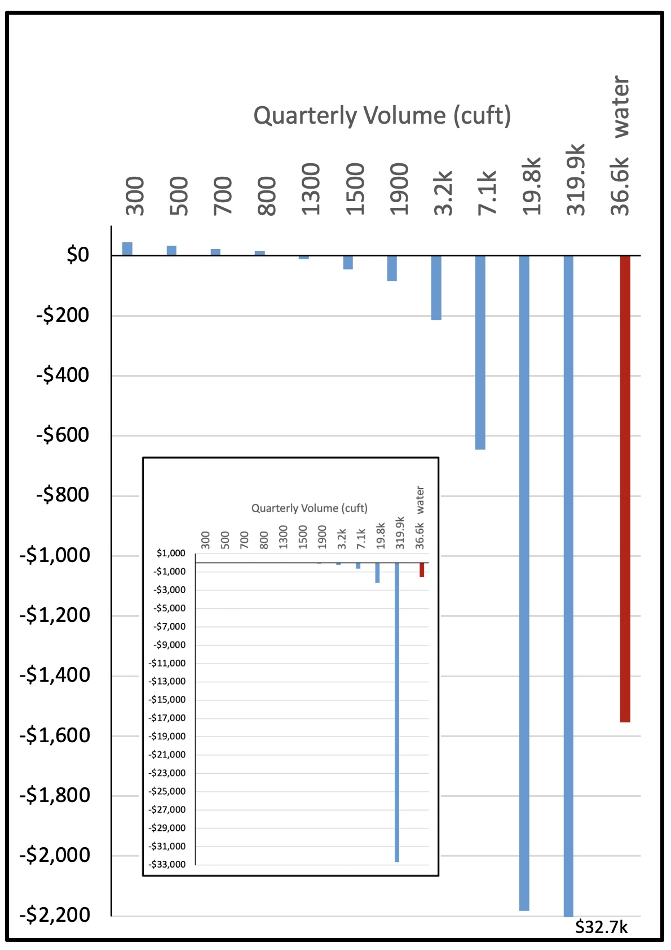
Impact of Proposed Rate Structure and Rates Across the Volume Spectrum
Bars represent differences in costs between the proposed and current rate structure and rates
Bars above the line show increased costs compared to current
Bars below the line show decreased costs compared to current

Slide 13
Recommendation #3: Proposed Select Board Review Frequency
Select Board reviews water and sewer rates and fund balances yearly
Adjustments can be made to the meter fee and rates as needed
  Comparing actual revenues with predicted revenues
  Adjusting revenue targets based on the current FY budget for the water and sewer enterprises
  Assessing use of fund balances relative capital improvement plans for the current FY year
Regular reviews and adjustments protect the rate payers from a single very large increase

Slide 14
Thank You

